Slide 1

Selective fiber losses in the auditory nerve as neural correlates of tinnitus
Graham Voysey
BE 710 Final Presentation
03 December 2013

Slide 2
Outline
Background
  The afferent auditory pathway -- a salient review
  Tinnitus
  “Hidden Hearing Loss” -- normal audiograms, damaged AN.
  Auditory Nerve Model candidates
Aims
Methods
Results

Slide 3
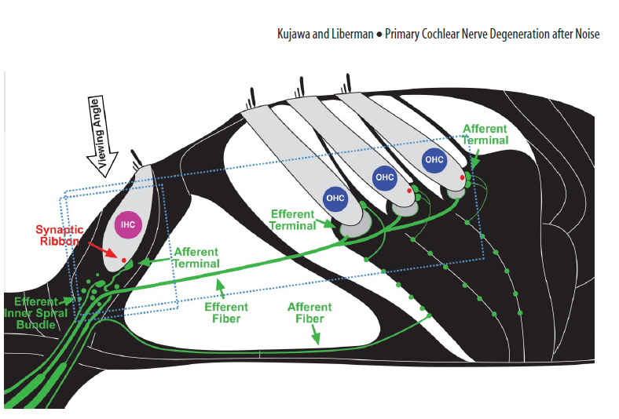
Cochlear Anatomy
Hair cells on the BM/Organ of Corti stimulate fibers of the Auditory Nerve.
  IHCs more heavily innervated by AN fibers than OHCs
  Efferent pathway poorly studied but known to be important (gain control? Noise Protection? (K&L 2013))
All AN Fibers are not created equal
  ~10% : low spontaneous rate (~10 spikes/sec
  ~30% : medium SR (~50)
  ~60% : high SR (~80)

Slide 4
CA Literature Rev.
2009: Kujawa and Liberman publish “Adding insult to injury: cochlear nerve degeneration after "temporary" noise-induced hearing loss.” (J. Neurosci).
  NIHL without hair cell loss
2011: “Primary neural degeneration in the Guinea pig cochlea after reversible noise-induced threshold shift.” (JARO)
  Repeat results in Gerbil
2013: “Noise-induced cochlear neuropathy is selective for fibers with low spontaneous rates.”
  Show selectivity of deafferentiation
2013: “Age-Related Cochlear Synaptopathy: An Early-Onset Contributor to Auditory Functional Decline”
  These results hold as merely a consequence of age

Slide 5
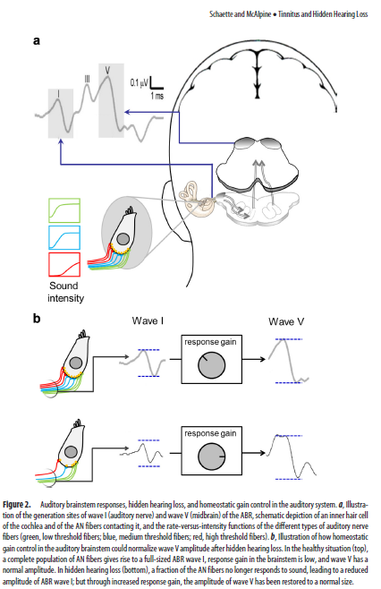
Tinnitus
“hidden hearing loss” can be thought to drive an increase in response gain
  Shown in this case to restore ABR wave V shape
Consequences:
  A greater population in A1 responds to a given CF (lack of sideband inhibition)
  Increased gain → hyperactivity.
  “The development of neural correlates of tinnitus constitutes a side-effect of … homeostatic plasticity.”

Slide 6
Tinnitus Literature Rev.
2006: Schaette et. al “Development of tinnitus-related neuronal hyperactivity through homeostatic plasticity after hearing loss: a computational model.” ( E. J. Neurosci)
  Examined a “balancing act” between SR proportionality in the AN fibers as an inhibitory model
  Disturbance to the balance → reassertion of homeostatis, but tinnitus as a consequence?
  Computational model
2011: Schaette and McAlpine “Tinnitus with a normal audiogram: physiological evidence for hidden hearing loss and computational model.”
  Evidence builds for deafferentiation-driven “maladaptive plasticity”
  Accurate prediction of percieved tinnitus pitch from measured audiometric data in patients
  “As neurons become more exiteable, spontaneous activity is amplified, leading to hyperactivity and the percept of tinnitus”.

Slide 7
Overall Goal
Show that selective damage to low spontaneous-rate AN fibers produces AN output which aligns well with emerging explanations of tinnitus

Slide 8
Specific Aims
Evaluate and select an auditory nerve model
Compare the effect of deafferentation on fiber response in low- and high- spont cases
Demonstrate that AN output resembles characteristic features of noise-induced tinnitus models

Slide 9
Model Selection
Carney et. al. have proposed a long-standing AN model
  “integrate-and-fire”, with many years of refinement
    Many sub-versions exist to fit specific applications
Zilany and Bruce (2006) “Modeling auditory-nerve responses for high sound pressure levels in the normal and impaired auditory periphery” (JASA)
  Important extension of AN models; includes very easily manipulable IHC/OHC contributions.
  Robust over a fairly wide input frequency range, intensity level.

Slide 10
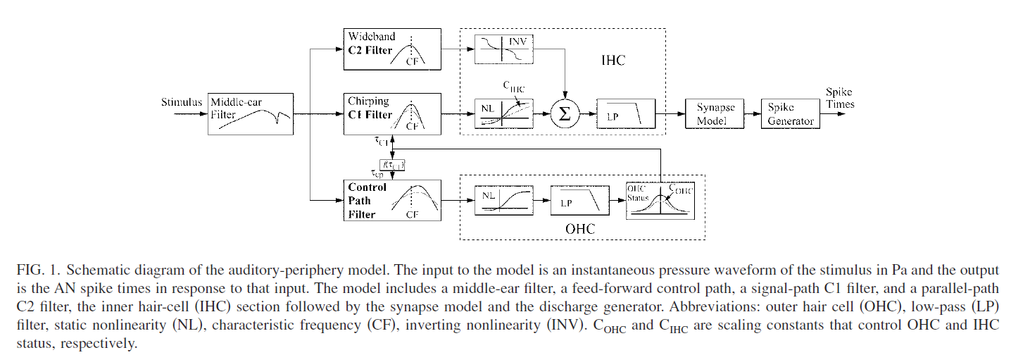
Zilany & Bruce, 2007r2

Slide 11
Methods
Simulate a collection of AN fibers
  Low and high spont rates
  Full contribution from OHC/IHC
  25,50,75% reduction in IHC
Compare across SR categories
Compare across IHC restriction

Slide 12
Methods - Parameters
Fibers
  One fiber for each CF on ⅓ octave bands from 80 Hz - 20 kHz
    good way to look at possible loss of inhibition
  Overall full OHC particiation
  Stimulus: 100ms duration, 5ms ramp, 50 dB SPL intensity.
  Sampling rate 200 kHz
Peristimulus Time Histograms
  50 repetition average
  Bin width 0.2ms
Spectrograms
  64-sample Hamming window, 50% overlap, 64-sample FFT
    good frequency resolution (but large side lobes → blur)

Slide 13
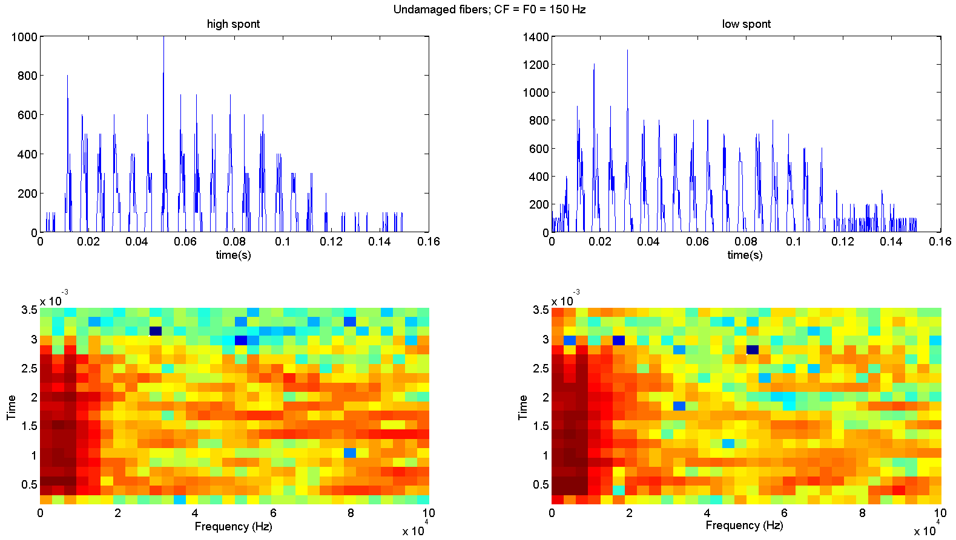
Results – Across S.R.
Fibers are tuned to the frequency they are stimulated at
Full IHC/OHC contribution in both cases – this is the model response of a healthy fiber
Phase-locking evident in both cases
Spectrograms show strong activation at target frequency
Windowing effects hide some harmonics

Slide 14
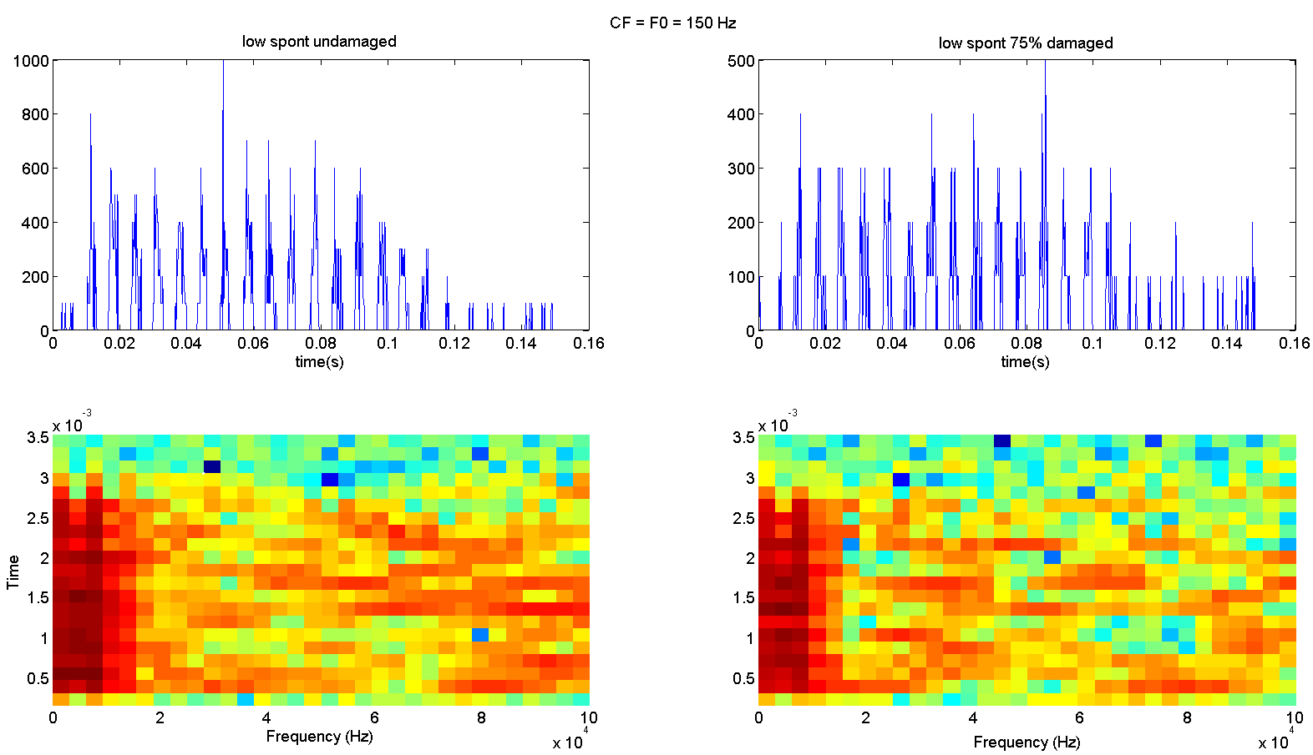
Results – Across damage
A low-spont fiber with 75% reduction in IHC control
Frequency response in spectrogram is still okay
  But noisier
Phase locking is starting to slip
The effective spont rate goes up for the damaged case
  Looks more like a high-spont fiber
PSTHs are also more noisy

Slide 15
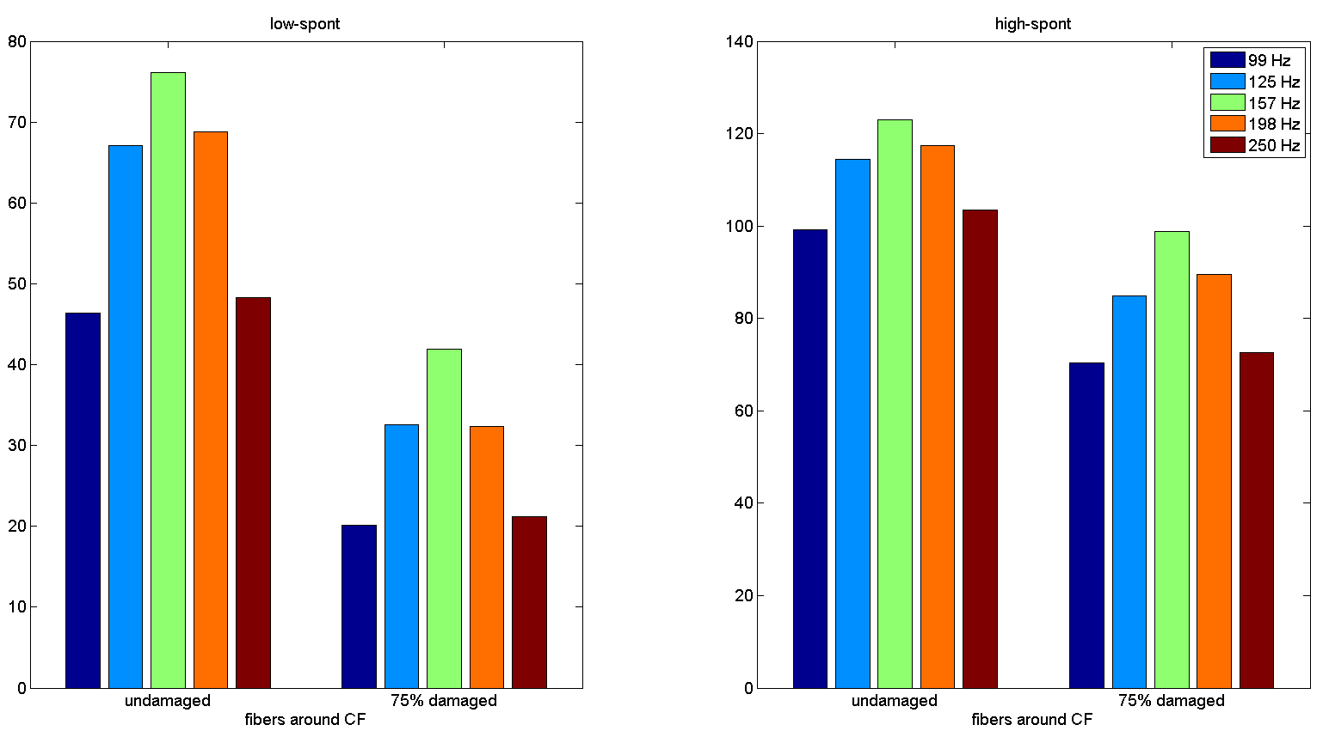
Results – Inhibition Loss
Changes in mean firing rate of PSTH over the response time
  For target CF and side-band
Low-spont fibers are proportionally more affected by damage in both overall firing rate contribution and tuning width.
High-spont fibers comparitively undamaged
This is consistent with the “normal audiogram/tinnitus” case

Slide 16
Next Step …?
Are the changes in an AN model reflected in an A1 tonotopic map and STRF model?
(mid-term paper presentation suggests this might be seen)

